Slide 1
CF969 - Big Data for Computational Finance Labs – 2. Pandas
Panagiotis Kanellopoulos

Slide 2
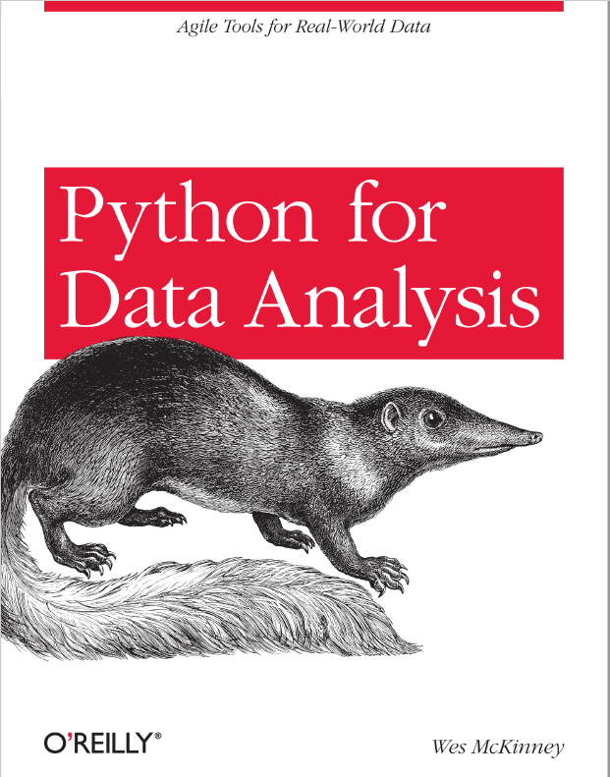
Pandas
Pandas is a package for data analysis and data manipulation in Python.
Written by Wes McKinney in 2012.
He has also written the book “Python for Data Analysis”.
Name comes from the term “panel data”.
Pandas/Python provides an alternative to R.

Slide 3
Why use Pandas?
Extensive support for working with structured data.
This is done in the form of two basic structures: DataFrames and Series.
Comparable to Numpy matrices and vectors, but with support for labelling, indexing, naming.
Also support for many operations specific to data analysis and data science.
Compared to R:
Pandas has the advantage of having access to a more powerful programming language (Python).
R still has more built-in support for specialised operations, and is still the standard for statisticians.

Slide 4
Reading data with Pandas
Very easy in pandas to read various standard file formats.
Example: to have pandas read a CSV (comma separated values) file we can write:
import pandas as pd
pima = pd.read_csv(“pima.csv”)
This reads the csv file pima.csv and loads it into a DataFrame object.
We may also specify an index by which we can access the rows of the loaded DataFrame.
import pandas as pd
pima = pd.read_csv(“pima.csv”, index_col=0)
Similar support exists for Excel files (as we will see in the labs).

Slide 5
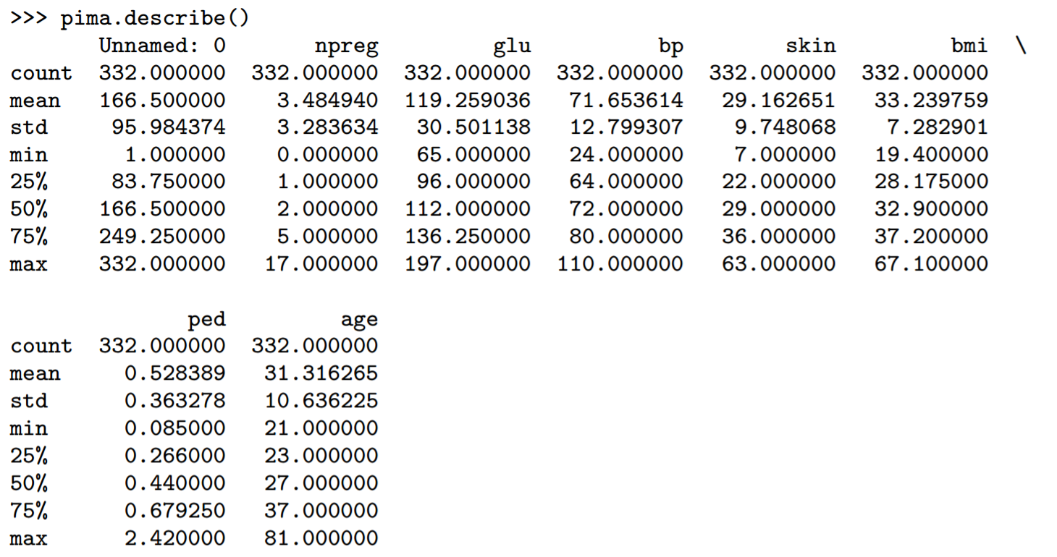
The describe Function
On a DataFrame, we can call describe for a summary of some commonly used statistics of the data.

Slide 6
Summary Statistics
Describe presents us various summary statistics over the rows of the DataFrame.
There are more such statistics, which can be called individually:
pima.count(), pima.mean(), pima.median(), pima.quantile(), pima.std(), pima.var(), pima.min(), pima.max()
By default these summary statistics are computed over the rows for each column.
Some of them can also be computed over the columns for each row, by using the axis=1 option.
pima.mean(axis=1)
There are many more built-in operations for summary statistics.
In the lab we will see the built-in functions for computing correlation and covariance.

Slide 7
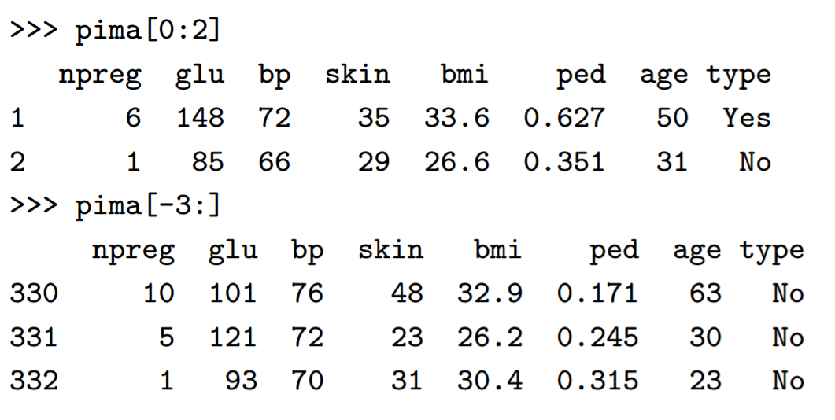
Indexing Rows
We can use our specified index for displaying or working with specified rows of the DataFrame.

Slide 8
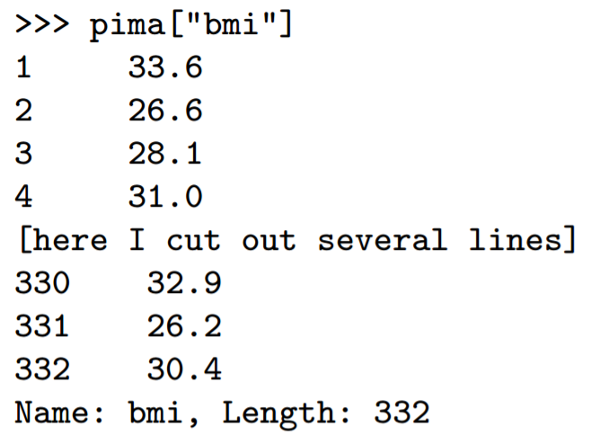
Indexing Columns
Indexing by specifying a column name will return that column as a Series object.

Slide 9
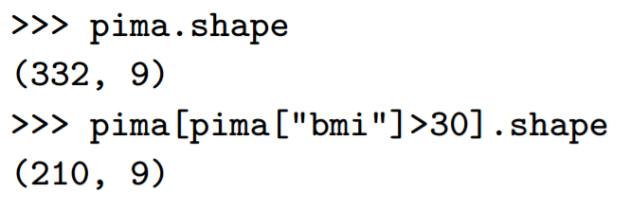
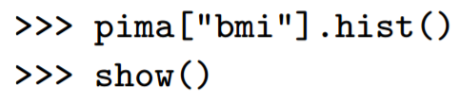
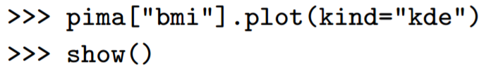
Shape, Conditional Indexing, and Plotting
The shape attribute keeps track of the number of rows and columns.
One may specify a logical condition in the index field to filter out rows of the DataFrame that satisfy the condition.
We can also create various plots and graphical representations of the DataFrame.
Example, for a histogram or a kernel density estimation plot:

Slide 10
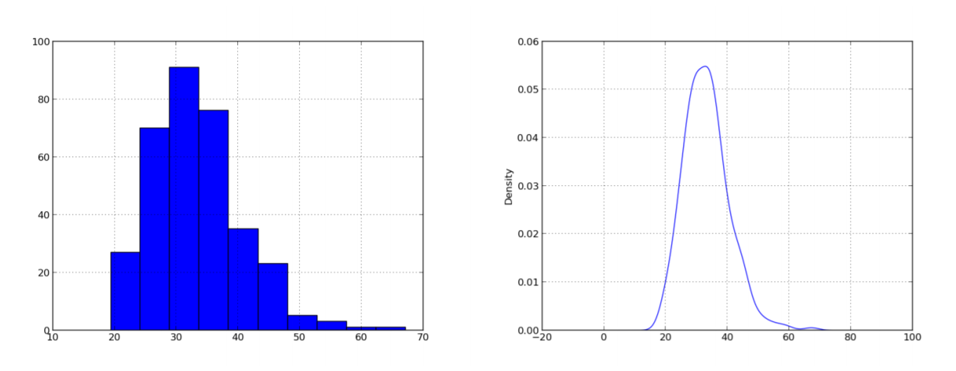
The Resulting Plots

Slide 11
Summary
Pandas helps you read, write, manage, and manipulate structured data.
It has support for indexing, labelling, and restructuring the data.
It can computing various summary statistics.
It has Python as an underlying programming language, allowing for implementing virtually any operation on your data.

Slide 12
Task for Lab 2:
You will work your way through the Introduction to Pandas chapter of the Statistical Analysis Python Tutorial.
Originally written by Christopher Fonnesbeck.
Adapted to achieve compatibility with the newest version of Pandas.
The tutorial can be found on this module’s Moodle page, in html and notebook format.
The original version by Fonnesbeck can be found here: https://github.com/fonnesbeck/statistical-analysis-python-tutorial/find/master
Necessary data files are also on Moodle. Copy these to your working directory.
Experiment with the code snippets to make sure you understand every bit of it.
Look up the documentation behind all the snippets of code so that you understand what is going on.

Slide 13
Additional Resources and Tasks
If the first chapter of the tutorial is too easy for you, see the other three chapters at https://github.com/fonnesbeck/statistical-analysis-python-tutorial/find/master
More complex tutorials in the Pandas Cookbook: http://pandas.pydata.org/pandas-docs/stable/cookbook.html
Have a look at the plotting docs at http://pandas.pydata.org/pandas-docs/stable/visualization.html#visualization
Dealing with potholes at https://www.usenix.org/system/files/login/articles/login1212_beazley.pdf
Useful cheat sheet for Python at https://www.cheat-sheets.org/saved-copy/NumPy_SciPy_Pandas_Quandl_Cheat_Sheet.pdf

